Slide 1
Stark Technology Inc.(2480)
2020Q2 Investor Conference

Slide 2
Safe Harbor Notice
There are variety of factors which may influence statements or contents been drafted within this presentation, therefore we strongly recommend audience to refer to the information published on MOPS website in case any adjustment has been made.

Slide 3
STI General Information
Founded in 1993, public traded in 2001
500+ Employees
The largest domestic system integrator in Taiwan
One of Taiwan’s top 500 service enterprises company.
Rated as Taiwan’s top 6% - 20% company over the 6th Corporate Governance Evaluation
2020/07/17 Included in the "Corporate Governance 100 Index"
Dedication to service and maintain 1,600+ majority of the 2,000+ company enterprise business
Providing more than 40 products & solutions to service our customers
Our vision is to assist our customers to become a Information Service Provider

Slide 4
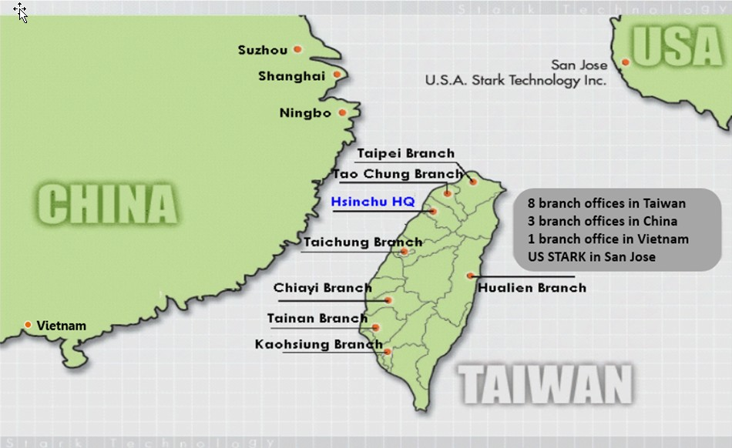
STI Service Network

Slide 5
Sales Operation – by Industries
Sales BU | Industry / Product / Region
BU1 | IBM products, High-tech industries, E-commerce, Finance, and Automobiles, the main area in Hsinchu and middle Taiwan.
BU2 | High-tech manufacturing, Defense, Military, and Traditional production, Education, the main area in Hsinchu、Taoyuan and South Taiwan
BU6 | Finance, insurance, telecommunications, small and medium enterprises, manufacturing in Taipei
 | The public sector including government, medical care, and education.
 | The main area in Taipei and East Taiwan
BU8 | Private telecommunications, film and television media, energy, water and electricity, the main area in Taipei
BU9 | Chunghwa Telecom

Slide 6









We’ve been worked and working on:
Cloud Services & Data Analytics
Infrastructure
internet
Enterprises
Factories
Enterprise/PC
Security Cloud
Big Data &
Computing
Cloud
Cable
Medical
Cloud
Enterprise Apps
Data Integration
Deep Learning
Analytics
Broadband
Home/PC
SmartTV
Buyers, Sponsors
Mobile APP
FSI Cloud
(Fintech, Blockchain)
4G/5G
Factory
Automation
Industry 4.0
IoT
WiFi
Smart Mobile
LoRa
Developers, Content Providers, Consumers
NB-IoT
IoT Devices
Inter-connect : Telecomm、Broadband/Cable、Internet
Multi-Screens : PC、NB/Pad、Smartphone、SmartTV

Slide 7
Information Technologies
Consulting
Design
Deployment
Integration
Portal Personalization Content Mgmt Single sign-on
Enterprise Apps
ERP,CRM,SCM
MES, PLM
OSS, VAS
Probe/CEM
eCommerce
High Freq. Trade by Trade
AML
Vertical Apps.
Professional
Services
IoT
(Environmental Monitoring)
MFG
Telco
FSI
Travel
Gov’t
Medical
EAI@SOA Middleware Data Integration@BI
Data Mgmt.
Security
System & Platform Resource Mgmt (CPU/GPU/VM/Container/Bare Metal)
Networking Platform Load Balancing Network Mgmt

Slide 8



AI(Machine、Deep Learning)
Data Science
Training
Modeling
Inference
Who? : End users
Who? : Auto ML
. Rapid ML/DL modeling,
. Manpower constraint
Who? : AI Engineer
. Process customization
. ML/DL inference deployment
STI : ML, DL computing hardware/software framework integration
3rd party alliance : Industrial domain consultant, Semi-auto. Tool vendor
AI Solution Consultant
Stack holder lead project
End-to-end solution planning
DL@GPU
Tech. staff training
Auto ML
IT lead project
Manpower constraint
Time to deployment
min. data input, max.
Workload@CPU or @GPU

Slide 9
Managed Security Service Provider(MSSP)
Global CTI Platform
Identity mgmt.@Cloud
STI
Security Services
Security Gears Deployment
& Fine tuning
VA@Cloud
On-Premise
Security Services
API Security@Cloud

Slide 10
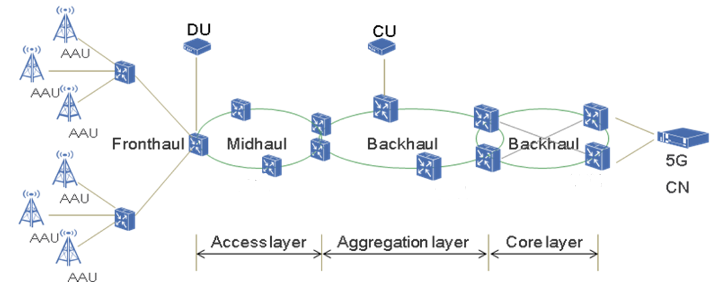
Tel-Communication Technologies (5G)
IP Core
Network
Small
Cell
OTN/Metro OTN
(5G Back-Haul)
Small Cell
Gateway
SD-WAN
(Software-Defined WAN)
(5G IP Core)
CWDM/NG-PON
(5G Front-Haul)

Slide 11
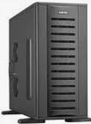






Meet up 5G + MEC@AI@Cloud
Smart City
Cloud@CN
GOV. Cloud
AI @DL,ML
A/R, V/R
AI@DL,ML Training @Cloud
Medical
Cloud
Autonomous Car
Entertainment
Automobile
AI @DL,ML
FSI Cloud
(Fintech, Blockchain)
Mobile APP
AI @DL,ML
AI @DL,ML
MFG.
Automation
Industry 4.0
IoT
MEC : Multi-Access Edge Computing
New Inference Feed
Training
Data Feed
Edge@RAN
Non-MEC Services
Non-MEC Services
MEC Services
MEC Services
MEC Servers
Inference@Edge
BS1
BS2
New Inference
Feed
Training
Data Feed
Inference@End-Point
Notes:
這張主要介紹5G+邊緣運算+AI對原本雲端服務增加的應用彈性

Slide 12


















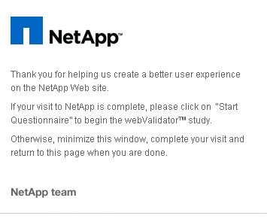









Products & Solutions
Info. Security
Software Development Tools
Resource MGMT.
Data MGMT.
Data Comm.
Open Systems
Telcomm.
STI Professional Service
Nokia Networks

Slide 13
Balance Sheet Overview (Consolidated)
Units:NT$ thousand
 | 2020/6/30 |  | 2019/12/31 |  | 2019/6/30
Item | AMT | % | AMT | % | AMT | %
Cash and cash equivalents | 1,510,047 | 29% | 1,567,177 | 30% | 1,434,356 | 30%
Accounts receivable(including contract assets) | 863,120 | 17% | 874,148 | 17% | 756,649 | 16%
Inventories | 1,516,008 | 29% | 1,470,524 | 29% | 1,421,322 | 29%
Property,Plant and equipment | 449,882 | 9% | 452,727 | 9% | 456,179 | 10%
Total Assets | 5,188,744 | 100% | 5,113,720 | 100% | 4,853,102 | 100%
Current Liabilities | 2,505,391 | 48% | 2,211,857 | 43% | 2,186,650 | 45%
Total Liabilities | 2,611,763 | 50% | 2,315,992 | 45% | 2,284,858 | 47%
Equity | 2,576,981 | 50% | 2,797,728 | 55% | 2,568,244 | 53%
Source: Market Observation Post System

Slide 14
Income Statements Overview (Consolidated)
Units: NT$ thousand
 | 2020 Jan.-June. |  | 2019 Jan.-June.
Item | AMT | % | AMT | % | YOY
Revenues | 2,634,084 | 100% | 2,594,155 | 100% | 1.5%
Gross profit | 661,584 | 25% | 666,157 | 26% | -0.7%
Operating expense | 379,508 | 14% | 388,661 | 15% | -2.4%
Operating income | 282,076 | 11% | 277,496 | 11% | 1.7%
Other income | 30,620 | 1% | 16,551 | 1% | 85.0%
Pre-tax income | 312,696 | 12% | 294,047 | 12% | 6.3%
Net income | 243,813 | 9% | 228,663 | 9% | 6.6%
EPS(NT$) | 2.29 |  | 2.15 |  | 6.5%
Source: Market Observation Post System
Note:China subsidiary’s revenue of consolidated: 2020Q2 5.74%;2019Q2 7.77%

Slide 15
Consolidated Revenues
QoQ
1.4%
YoY
10.4%
Units: NT$ thousand

Slide 16
Consolidated Gross profit%
QoQ
-0.7pt
YoY
-0.6pt

Slide 17
Consolidated Operating expenses
QoQ
14.2%
Units: NT$ thousand
YoY
10.1%

Slide 18
Consolidated Operating income
QoQ
-18.8%
YoY
4.0%
Units: NT$ thousand

Slide 19
Consolidated Operating income%
QoQ
-2.4pt
YoY
-0.6pt

Slide 20
Consolidated Net income
QoQ
-12.7%
YoY
7.3%
Units: NT$ thousand

Slide 21
Consolidated Net income%
QoQ
-1.4pt
YoY
-0.2pt

Slide 22
Consolidated EPS
QoQ
-12.3%
YoY
7.0%
Units: NT$

Slide 23
Sales Revenue & Net Income

Slide 24
EPS & Capital
 | 2020 Q2 | 2019 | 2018
ROE | 9.07 | 16.42 | 15.64

Slide 25
2020Q2 Sales Revenues by Type
Revenue:2.634billion

Slide 26
Comparison of Sales Revenues by Type

Slide 27
Compare Sales Revenues by Type
Unit:NT K$ | 2020Q2 | 2019Q2
Product Sales | 1,912,724 | 1,836,409
Consulting /Maintenance | 713,071 | 751,511
Other | 8,289 | 6,235
Total | 2,634,084 | 2,594,155
Revenue:2.634billion
Revenue:2.594billion

Slide 28
2020Q2 Sales Revenues by Industry
Revenue:2.634billion

Slide 29
Comparison of Sales Revenues by Industry(Accumulated)

Slide 30
Comparison of Sales Revenues by Region(Accumulated)

Slide 31
Quarterly revenue status
Units:NT$ thousand

Slide 32
Q & A
Thank you!!

