Slide 1
Stark Technology Inc.(2480)
2019Q3 Investor Conference

Slide 2
Safe Harbor Notice
There are variety of factors which may influence statements or contents been drafted within this presentation, therefore we strongly recommend audience to refer to the information published on MOPS website in case any adjustment has been made.

Slide 3
STI General Information
Founded in 1993, public traded in 2001
485+ Employees
The largest domestic system integrator in Taiwan
One of Taiwan’s top 500 service enterprises company.
Rated as Taiwan’s top 6% - 20% company over the 5th Corporate Governance Evaluation
Dedication to service and maintain 1,600+ majority of the 2,000+ company enterprise business
Providing more than 40 products & solutions to service our customers
Our vision is to assist our customers to become a Information Service Provider

Slide 4
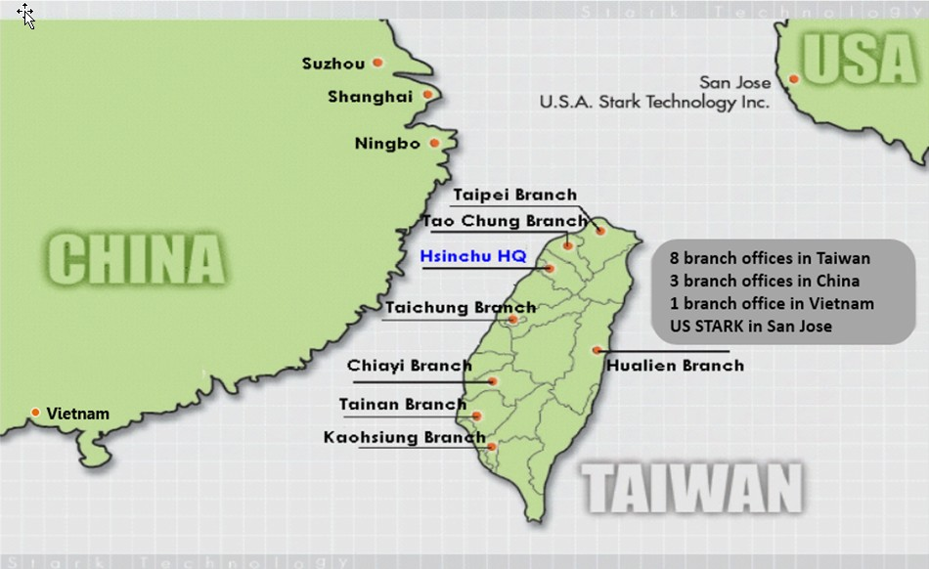
STI Service Network

Slide 5
Sales Operation – by Industries
Sales BU | Industry / Product / Region
BU1 | IBM products, High-tech industries, E-commerce, Finance, and Automobiles, the main area in Hsinchu and middle Taiwan.
BU2 | High-tech manufacturing, Defense, Military, and Traditional production, Education, the main area in Hsinchu、Taoyuan and South Taiwan
BU6 | Finance, insurance, telecommunications, small and medium enterprises, manufacturing in Taipei
 | The public sector including government, medical care, and education.
 | The main area in Taipei and East Taiwan
BU8 | Private telecommunications, film and television media, energy, water and electricity, the main area in Taipei
BU9 | Chunghwa Telecom

Slide 6









We’ve been worked and working on:
Cloud Services & Data Analytics
Infrastructure
internet
Enterprises
Factories
Enterprise/PC
Security Cloud
Big Data &
Computing
Cloud
Cable
Medical
Cloud
Enterprise Apps
Data Integration
Deep Learning
Analytics
Broadband
Home/PC
SmartTV
Buyers, Sponsors
Mobile APP
FSI Cloud
(Fintech, Blockchain)
4G/5G
Factory
Automation
Industry 4.0
IoT
WiFi
Smart Mobile
LoRa
Developers, Content Providers, Consumers
NB-IoT
IoT Devices
Inter-connect : Telecomm、Broadband/Cable、Internet
Multi-Screens : PC、NB/Pad、Smartphone、SmartTV

Slide 7
Information Technologies
Consulting
Design
Deployment
Integration
Portal Personalization Content Mgmt Single sign-on
Enterprise Apps
ERP,CRM,SCM
MES, PLM
OSS, VAS
Probe/CEM
eCommerce
High Freq. Trade by Trade
AML
Vertical Apps.
Professional
Services
IoT
(Environmental Monitoring)
MFG
Telco
FSI
Travel
Gov’t
Medical
EAI@SOA Middleware Data Integration@BI
Data Mgmt.
Security
System & Platform Resource Mgmt (CPU/GPU/VM/Container/Bare Metal)
Networking Platform Load Balancing Network Mgmt

Slide 8



AI(Machine、Deep Learning)
Data Science
Training
Modeling
Inference
Who? : End users
Who? : Auto ML
. Rapid ML/DL modeling,
. Manpower constraint
Who? : AI Engineer
. Process customization
. ML/DL inference deployment
STI : ML, DL computing hardware/software framework integration
3rd party alliance : Industrial domain consultant, Semi-auto. Tool vendor
AI Solution Consultant
Stack holder lead project
End-to-end solution planning
DL@GPU
Tech. staff training
Auto ML
IT lead project
Manpower constraint
Time to deployment
min. data input, max.
Workload@CPU or @GPU

Slide 9








Security Cloud Service model
Strategic alliance
Public Cloud
(AWS,Azure,GCP)
Service offering
Internet
System inter-connect
Security Service Vendor
HQ office
Branch office
Security
Intelligence Vendor
Security Cloud Service
SmartMoble@Employee
Secure connection, management, threat analysis & report services
Cyber Threat Intelligence analysis & detection services
Secure access authentication, authorization & apps. Platform services
Secure AIoT inter-connect platform
EAR app platform
Access Authentication
Open API
RESTful API
Biz. partner
e.g.：
Access Authorization
Management
Secure Medical Apps access
Secure payment service
Customers
.
.

Slide 10
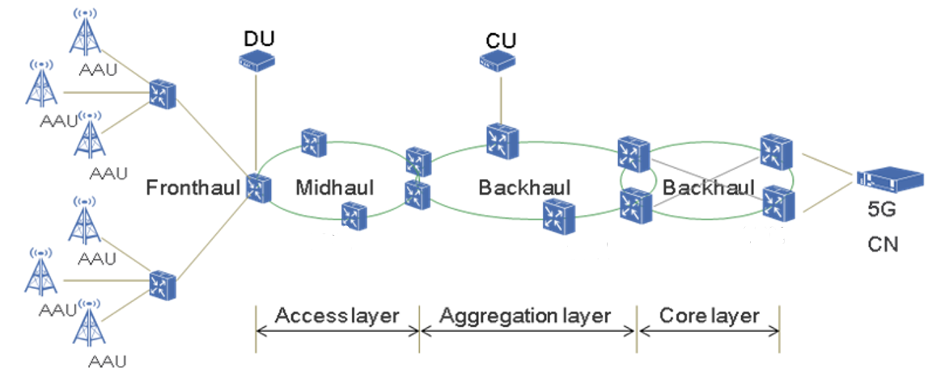
Tel-Communication Technologies (5G)
IP Core
Network
Small
Cell
OTN/Metro OTN
(5G Back-Haul)
Small Cell
Gateway
SD-WAN
(Software-Defined WAN)
(5G IP Core)
CWDM/NG-PON
(5G Front-Haul)

Slide 11














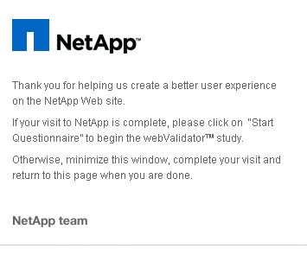















Products & Solutions
Info. Security
Software Development Tools
Resource MGMT.
Data MGMT.
Data Comm.
Open Systems
Telcomm.
STI Professional Service
Nokia Networks

Slide 12
Balance Sheet Overview (Consolidated)
Units:NT$ thousand
 | 2019/9/30 |  | 2018/12/31 |  | 2018/9/30
 | AMT | % | AMT | % | AMT | %
Cash and cash equivalents | 1,153,632 | 25% | 1,310,169 | 26% | 1,261,214 | 28%
Accounts receivable(including contract assets) | 730,262 | 15% | 828,304 | 16% | 777,954 | 17%
Inventories | 1,403,166 | 30% | 1,697,084 | 34% | 1,370,863 | 31%
Property,Plant and equipment | 456,062 | 10% | 460,339 | 9% | 462,858 | 10%
Total Assets | 4,656,078 | 100% | 4,963,595 | 100% | 4,476,561 | 100%
Current Liabilities | 1,862,993 | 40% | 2,267,502 | 46% | 1,897,699 | 42%
Equity | 2,692,686 | 58% | 2,639,555 | 53% | 2,526,294 | 57%
Source: Market Observation Post System

Slide 13
Income Statements Overview (Consolidated)
Units: NT$ thousand
 | 2019 Jan.-Sep. |  | 2018 Jan.-Sep.
Item | AMT | % | AMT | % | YOY
Revenues | 3,938,101 | 100% | 3,342,424 | 100% | 17.8%
Gross profit | 949,803 | 24% | 977,465 | 29% | -2.8%
Operating expense | 576,728 | 15% | 624,359 | 19% | -7.6%
Operating income | 373,075 | 9% | 353,106 | 10% | 5.7%
Other income | 41,621 | 1% | 22,722 | 1% | 83.2%
Pre-tax income | 414,696 | 10% | 375,828 | 11% | 10.3%
Net income | 323,658 | 8% | 283,116 | 8% | 14.3%
EPS(NT$) | 3.04 |  | 2.66 |  | 14.3%
Source: Market Observation Post System
Note:2019Q3 revenue and increased by 595,677K from the last year, mainly due to the long period of construction of some large-scale projects.; EPS was NT$3.04

Slide 14
Comparison of Consolidated Income
Units: NT$ thousand
QoQ Comparison of 2019Q3
YoY Comparison of 2019Q3
 | 2019Q3 | 2019Q2 | QoQ
Revenues | 1,343,946 | 1,201,525 | 11.9%
Gross profit | 283,646 | 305,336 | -7.1%
Gross profit% | 21% | 25% | -16.9%
Operating income | 95,579 | 121,571 | -21.4%
Pre-tax income | 120,649 | 130,892 | -7.8%
Net income | 94,995 | 105,987 | -10.4%
EPS | 0.89 | 1.00 | -11.0%
 | 2019Q3 | 2018Q3 | YoY
Revenues | 1,343,946 | 1,019,661 | 31.8%
Gross profit | 283,646 | 304,814 | -6.9%
Gross profit% | 21% | 30% | -29.4%
Operating income | 95,579 | 98,000 | -2.5%
Pre-tax income | 120,649 | 107,097 | 12.7%
Net income | 94,995 | 81,933 | 15.9%
EPS | 0.89 | 0.77 | 15.6%

Slide 15
Sales Revenue & Net Income

Slide 16
EPS & Capital

Slide 17
2019Q3 Sales Revenues by Type
Revenue:3.938billion

Slide 18
Comparison of Sales Revenues by Type

Slide 19
Compare Sales Revenues by Type
Revenue:3.938billion
Revenue:3.342billion

Slide 20
2019Q3 Sales Revenues by Industry
Revenue:3.938billion

Slide 21
Comparison of Sales Revenues by Industry

Slide 22
Comparison of Sales Revenues by Region

Slide 23
Quarterly revenue status
Units:NT$ thousand

Slide 24
Q & A
Thank you!!

